Slide 1
Next level non-animal testing:
3R TOXFLOW & DARTpaths results at a glance
Marjolein Wildwater, CEO Vivaltes
3R TOXFLOW (Project leader, HU)
DARTpaths (Project leader, Vivaltes)

Slide 2
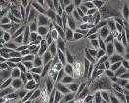


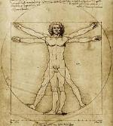
Opportunities to discover & understand health effects using test-animal free methods
Chemical structure-activity information (QSARs)
In vitro assays
In vivo alternative test systems
e.g.
EST
New Alternative Methodologies (NAMs)
Animal tests (rat & rabbit)
Human

Slide 3
in vivo test animal-free systems as promising tools for compound-induced effects
Unique features
Challenges
3D systems with tissues and organs
Well-known (molecular) systems
Conserved molecular and cellular pathways
Huge amount of available tools/technologies
High throughput
Lower cost
Rapid generation time
Further requirements for validation and determination of applicability domain
Not yet accepted by regulators

Slide 4
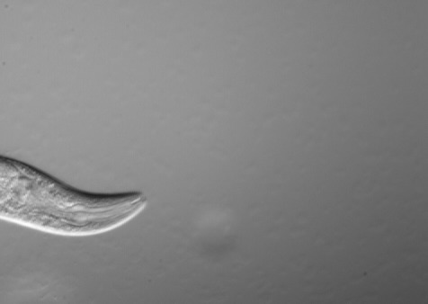

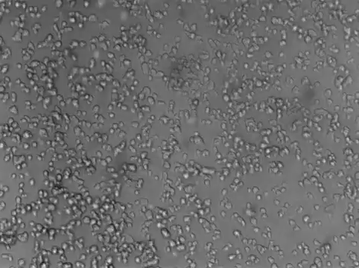
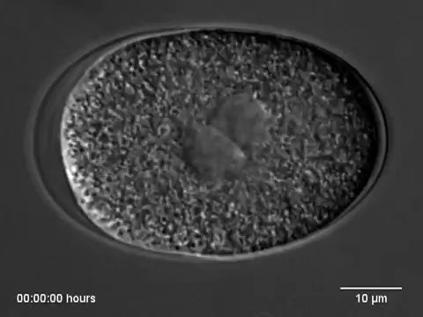
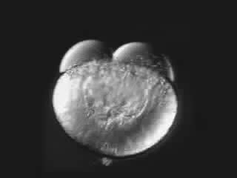
D. discoideum, C. elegans and zebrafish as
New Alternative Methodologies (NAMs)
You tube: by Tglab
You tube: tony hyman lab
You tube: Karlstrom and Kane
D. discoideum
C. elegans
Zebrafish
What makes these organisms predictable for effects in humans???

Slide 5
Predictive results due to evolutionary conserved biology
Healthy
Affected
Human
Mouse
Zebrafish
Nematode
C. elegans
Washington et al PLoSBiol e1000247

Slide 6

Pre-DART &
EFRO TOXFLOW
Combinatorial testing shows added value in predicting Developmental and Reproductive toxicity in three species
Initial comparison table
Notes:
The advantages of the test systems include rapid high throughput screening, short turnover time enabling the entire developmental and reproductive cycle to be examined and easy identification of adverse outcomes pathways and molecular initiating events. The assays have been validated using well characterized DART positive and negative compounds and D. Discoideum, C.elegans and D.rerio detected DART compounds with assay sensitivity values of 87%, 87% and 74%, respectively. Using a combination of all three test systems increases the sensitivity to 92%, highlighting the value of the combinatorial approach.
Company Vivaltes was formed as a result of the Challenge and can be contacted via their website

Slide 7
3R TOXFLOW was to further improve confidence of NAMs for industrial use
Key focus of 3R TOXFLOW laboratory testing project
Interlaboratory reproducibility of laboratory tests (C. elegans)
Development of new and refined assays to evaluate toxicity
Testing high number of UVCBs and compounds to further expand knowledge
Development of improved exposure methodology
Understanding mechanisms of action (Adverse outcome pathways)
Cross species data integration
Compounds of Unknown or Variable Composition, Complex Reaction Products and Biological Materials (UVCB Substances)

Slide 8
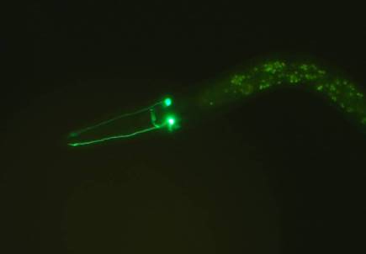
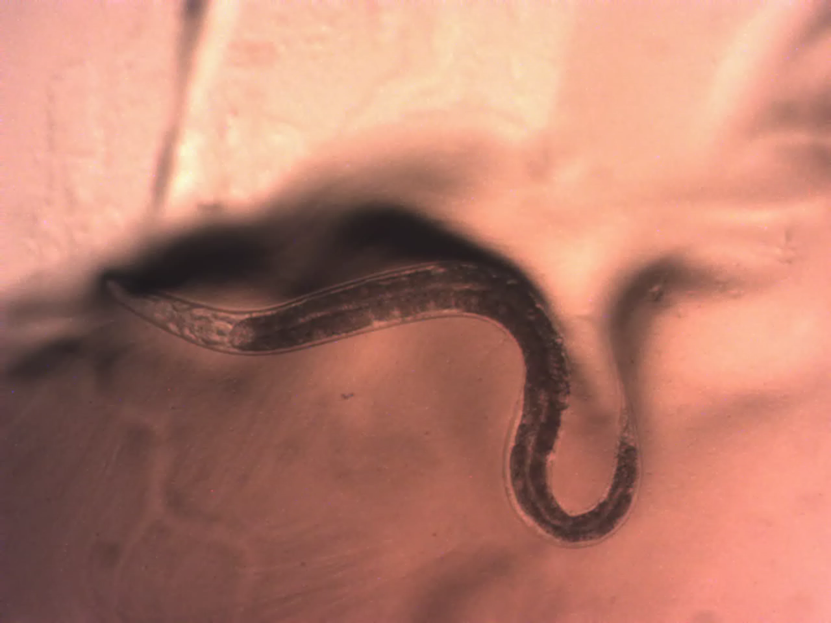
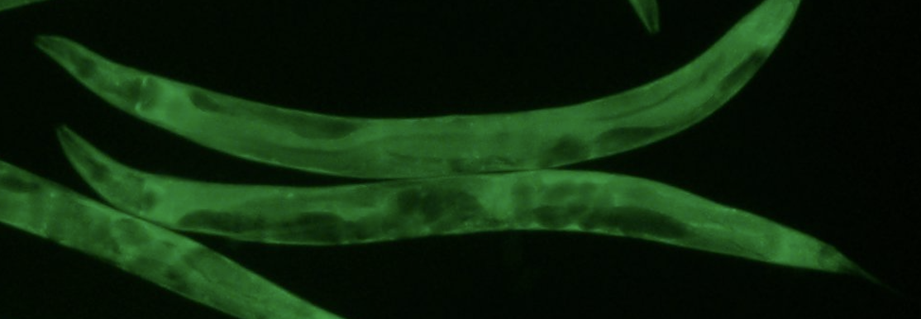
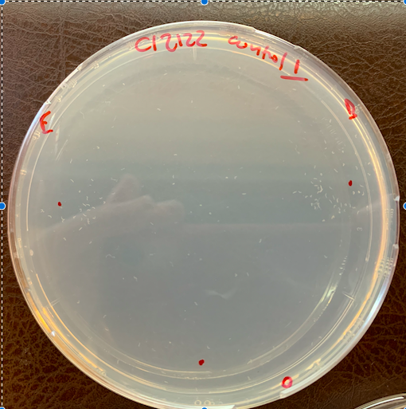
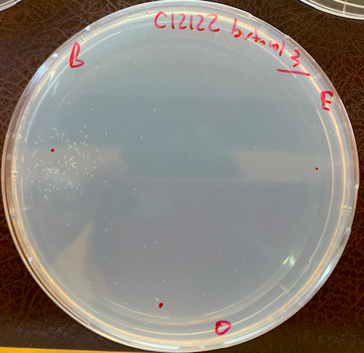
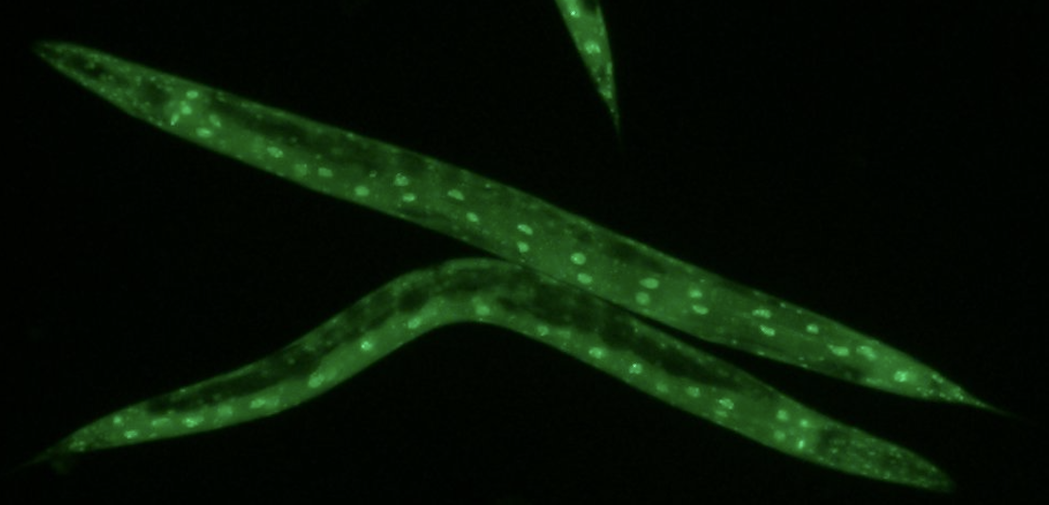
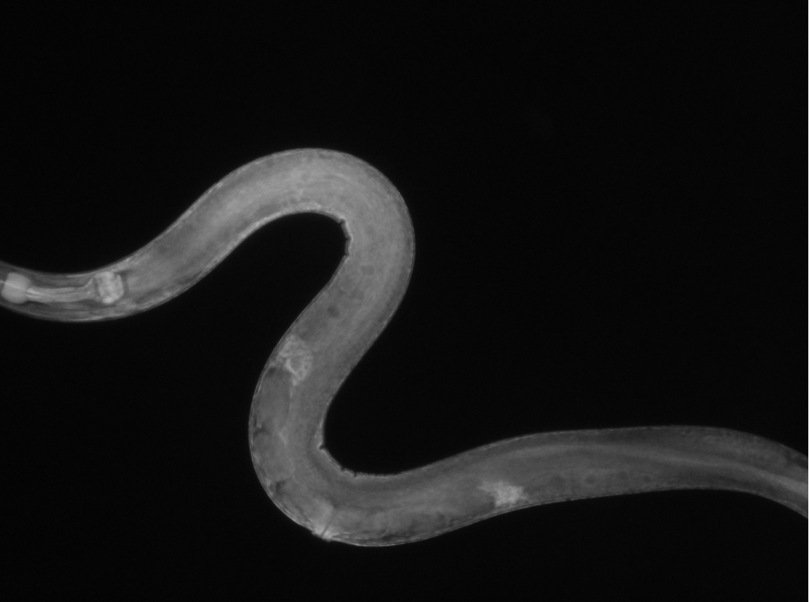
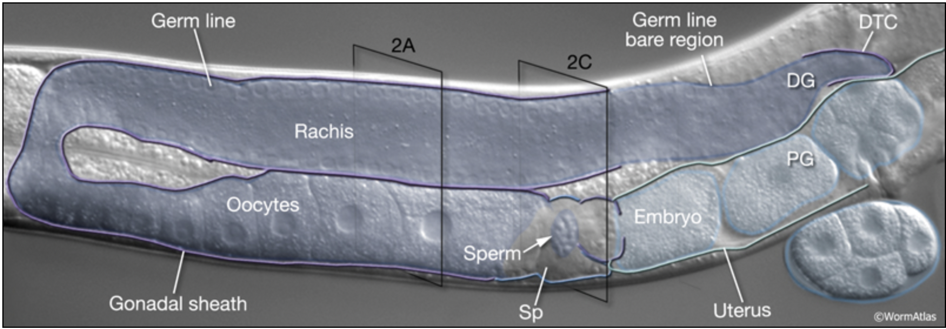
Which toxicity endpoints do you evaluate when using small organisms?
Body fat
Eating (pharyngeal pumping)
Control
Serotonergic neuron
Organisms protective gene activation as response to stress
Reduced fat levels
Oocytes
Nervous system assessment
Notes:
Calcium signaling:
https://www.youtube.com/watch?v=1mun87TOnTk

Slide 9
Working towards a robust and reliable integrated testing strategy using NAMs
What
Conserved effects for higher organisms and humans
Reliable outcomes: (exposure versus biological effect)
Ability to screen for relevant and refined endpoints: targeted testing
Data integration by combining data from different methodologies

Slide 10
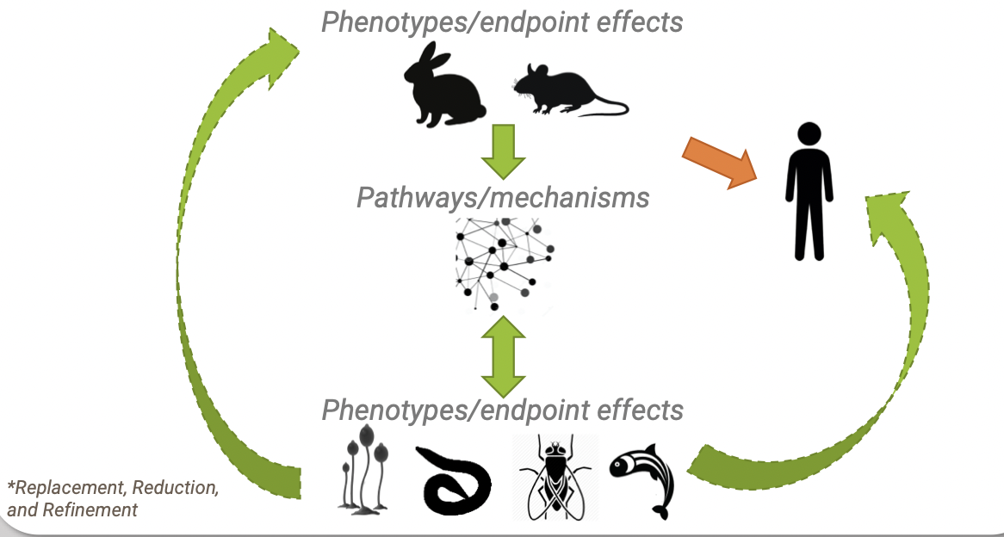
The key for acceptance & adaptation of alternative testing strategies is cross-species conservation
from phenotypes to molecular mechanisms and vice versa

Slide 11
Focus of DARTpaths is to improve prediction & proper test selection by data analytics
Key focus of DARTpaths data analytics project
Taking advantage of existing data from scientific sources
Interconnecting this data with new test methodologies to improve predictions
Bridging the gap and building bridges between old and new test strategies

Slide 12
Economical perspective of 3R TOXFLOW & DARTpaths
Political aim of the Netherlands to become one of the leading countries with regards to animal free testing & innovations
High reliability of NAM assays due to combinatorial approach of state of the art data analytical science & different laboratory assays
Shorter run-through pipelines (1-2 weeks) when compared to golden standard animal tests (months) & lower costs
NAM tests are successfully brought to the market (TLR9)

Slide 13
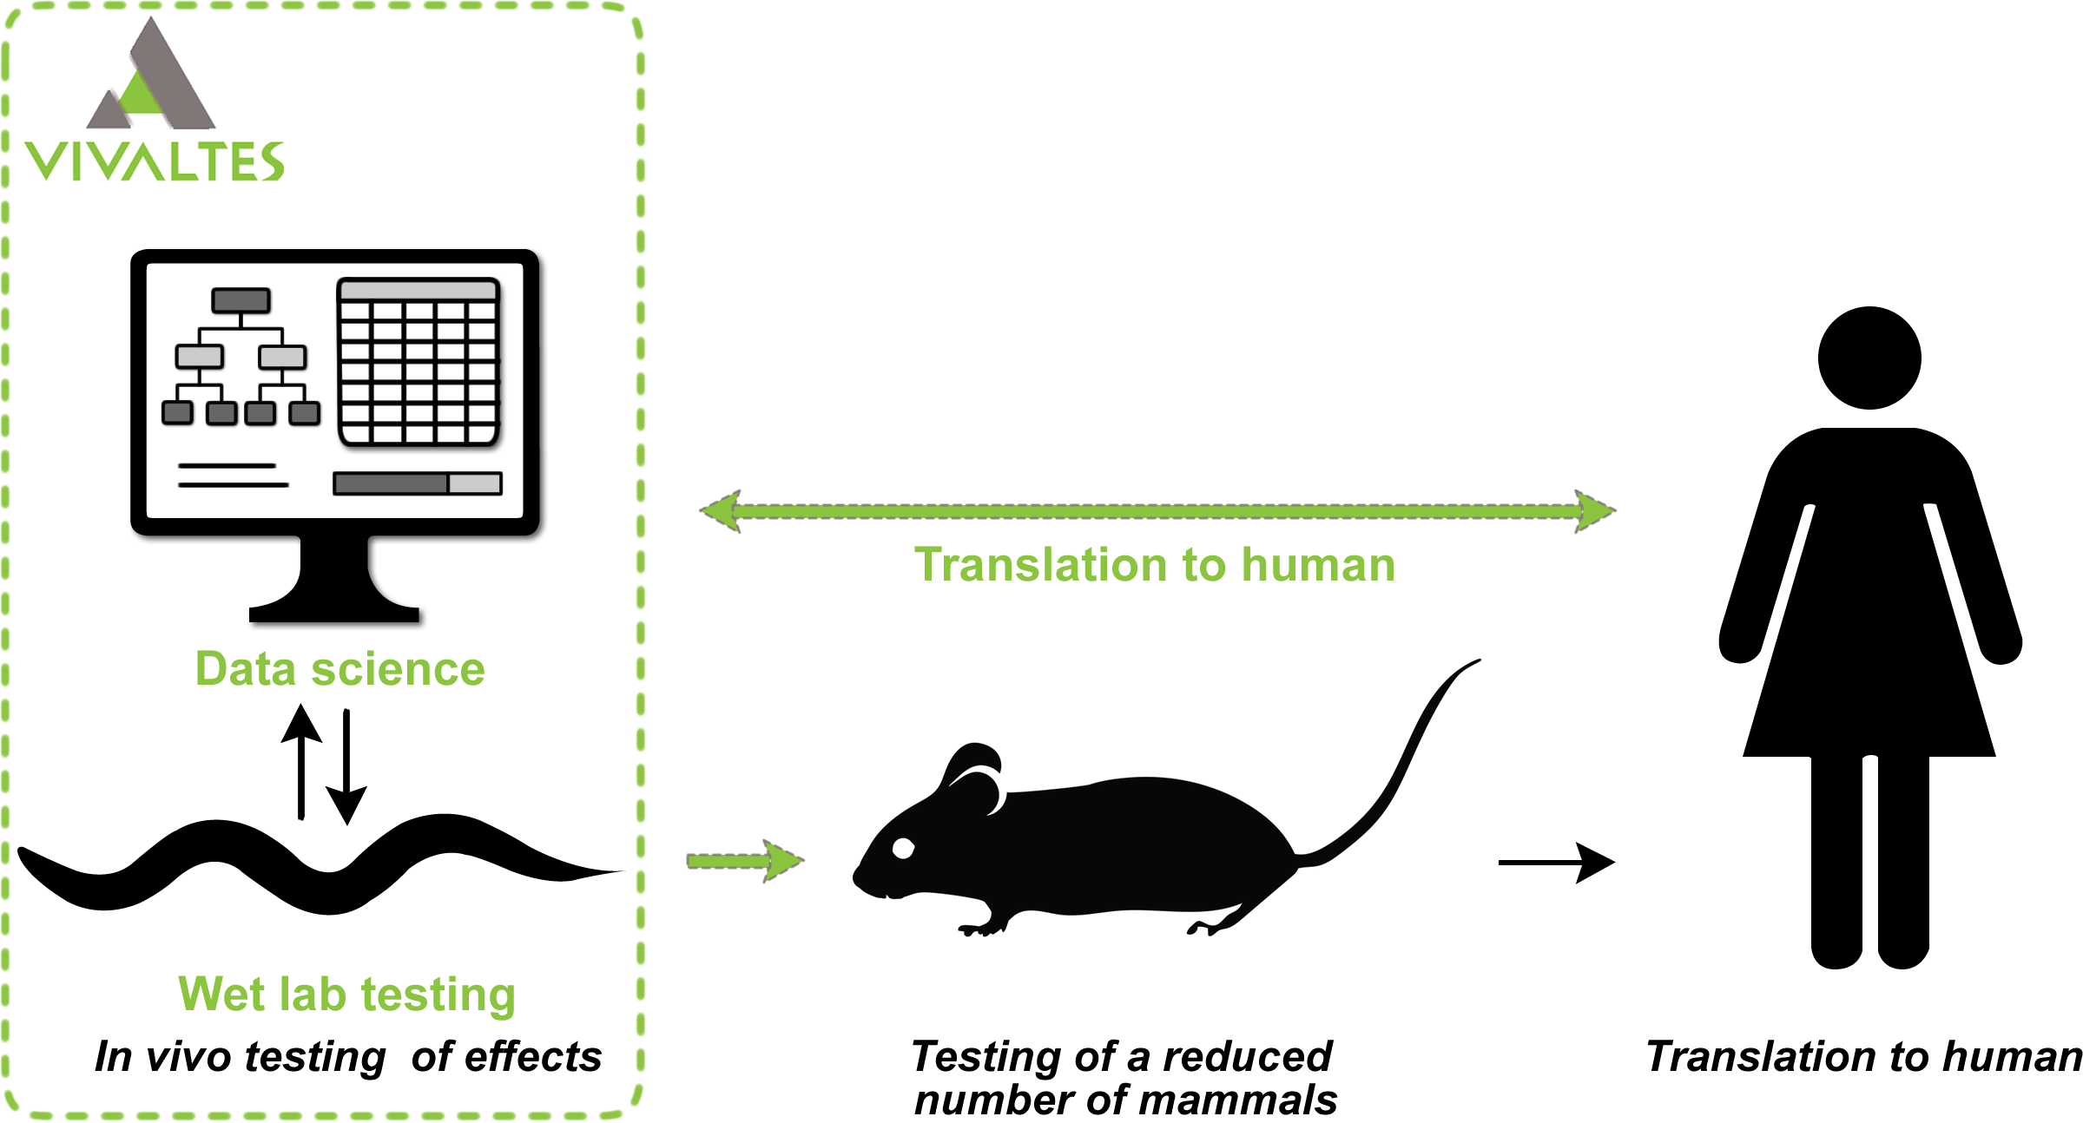
Vivaltes as successful industrial partner for implementation of 3R testing knowledge

Slide 14


Vivaltes assists clients by combining cutting edge science with interactive customized service
Vivaltes mission: to reduce the burden & costs of animal testing
by offering alternatives opportunities
Vivaltes core values: to deliver the best service
to continuously improve our products
authenticity & transparency
Vivaltes facts: founded in Nov 2016 as spin off from the HU
currently 11 fte
assisted with 7 industrial patent applications
moved into own laboratory in 2022
awarded twice

Slide 15
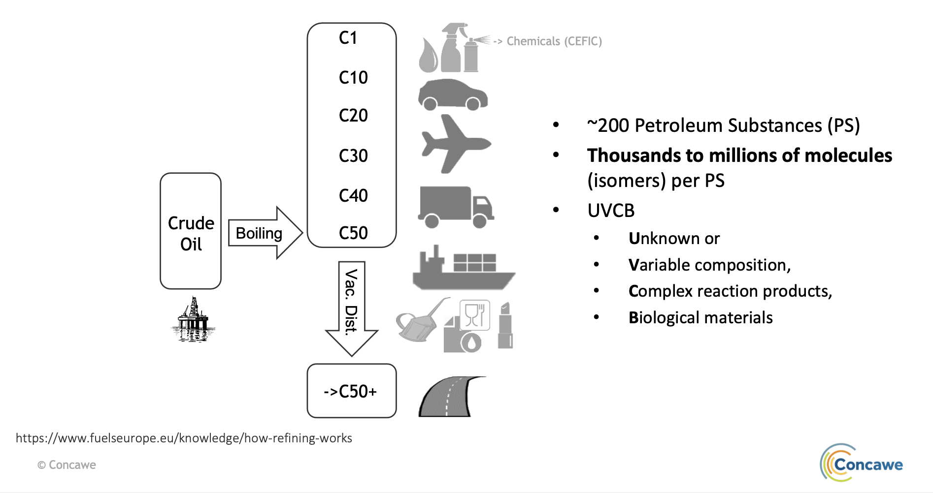
Petroleum substances form a huge toxicological challenge world wide

Slide 16
Testing higher numbers of compounds and substances in 3R TOXFLOW indicate reliable data from NAM methodologies
Unique opportunity provided by petrochemical industry:
Acknowledgements to Juan-Carlos Carrillo, Martijn Rooseboom, Chantal Smulders, Hans Ketelslegers, Mike Penman, Jean-Philippe Gennart
highly characterized petroleum UVCBs (tested in animals)
Organs of animals used in 3R TOXFLOW for testing align NAMs with golden standard tests
Examples of NAM assays with good correlations:
Mouse embryonic stem cell test (EST) (Lenny Kamelia, Jochem Louisse, Ivonne Rietjens, Peter Boogaard)
CALUX Reporter Gene Assays (Lenny Kamelia, Jochem Louisse, Ivonne Rietjens, Peter Boogaard)
Human H295R cells (Jochem Luisse)
Zebrafish embryotoxicity test (Jing Fang, Peter Boogaard, Ivonne Rietjens, Lenny Kamelia)
C. elegans assays (Nienke Stigter, Johanna Louter, Amra Milasinovic)
Notes:
WFSR assessed the effects of a series of model compounds and petroleum UVCBs on the production of a range of steroid hormones by human H295R cells using LC-MS-based quantification. The model compounds affected the steroid hormone production as expected, confirming the validity of the test system, and for some petroleum UVCBs also effects on steroid hormone production was found. This indicates a potential hormone disruptive effect of some of the petroleum UVCBs, being a possible indication of adverse effects on reproduction and/or development. In the next phase, for selected UVCBs concentration-dependent effects will be studied and new UVCB samples will be tested.
Steroid production GC MS

Slide 17

Mapping cross-species endpoints into an evolutionary conserved mechanistical profile to understand toxicity
Phenomics
Organism
Organism
DARTpaths
Proteomics/Kinomics
Metabolomics
Tissues & organs
Tissues & organs
3R TOXFLOW
Signaling pathways
Signaling pathways
RNA seq
DNA RNA Protein Metabolite
DNA RNA Protein Metabolite
Genomics

Slide 18
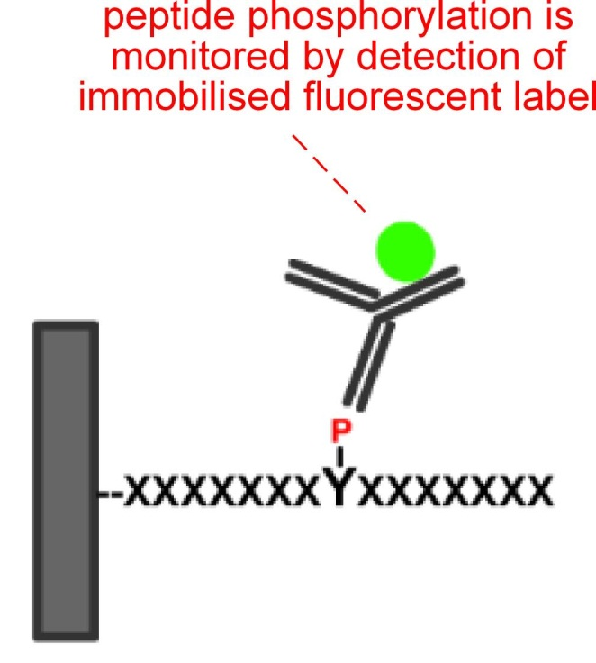
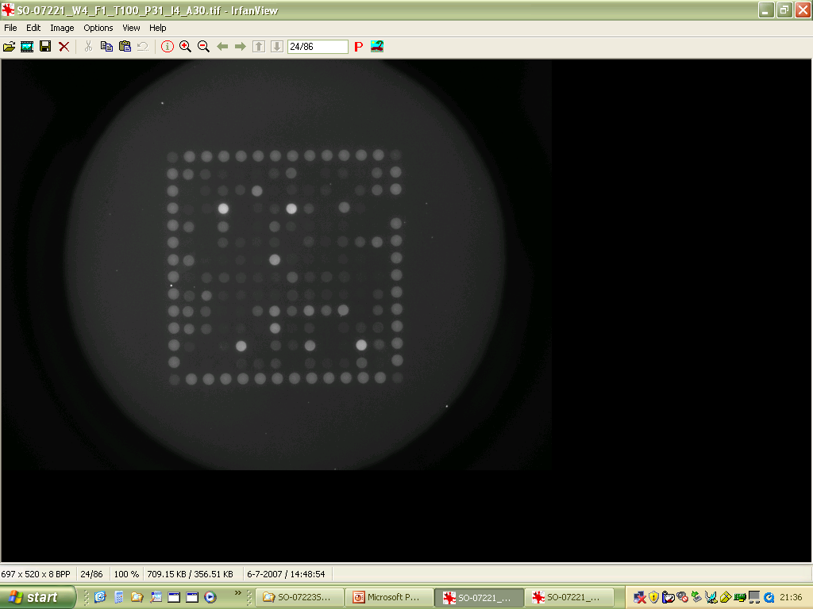
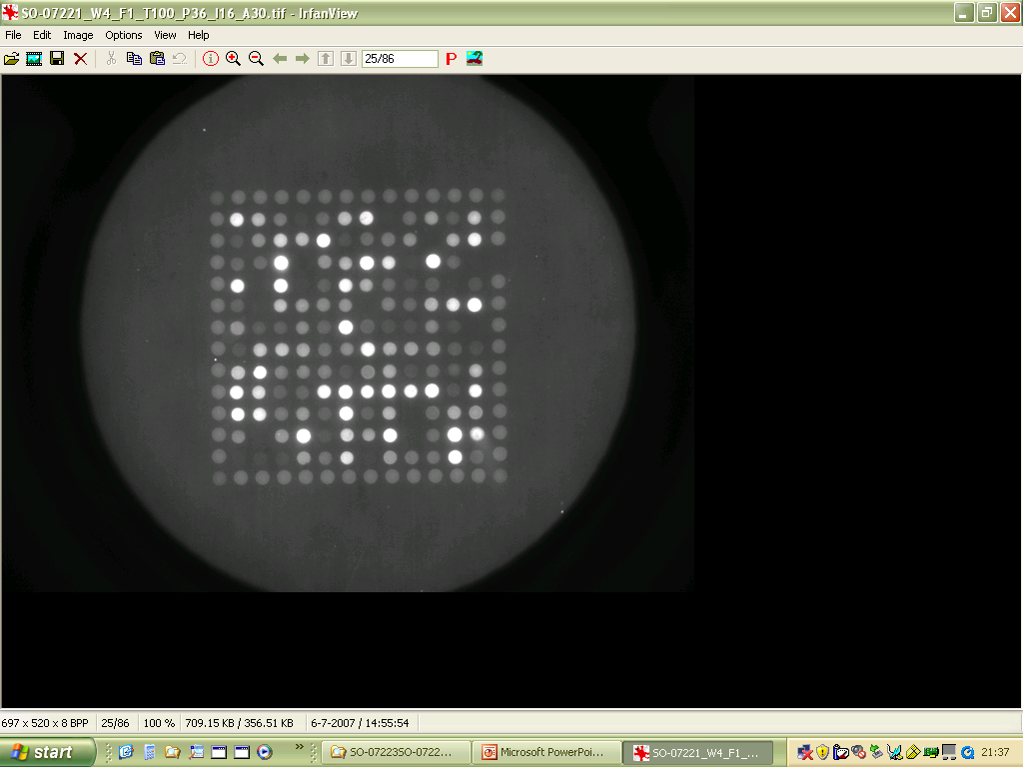
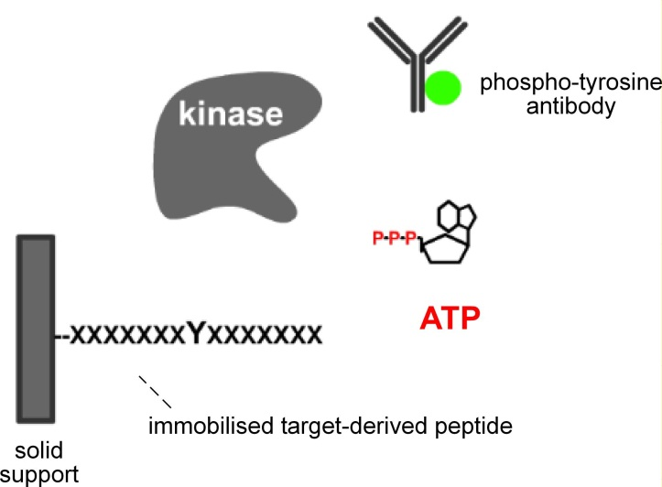
Kinomics approach in 3R TOXFLOW to reveal compound mode of action
Effects on kinase activity after treatment with either toxic or non-toxic compounds & UVCBs
Pamgene
Control
Treatment
Dirk Pijnenburg

Slide 19
Some highlights of 3R TOXFLOW & DARTpaths are presented today
NAM test predictivity: Jochem Louisse (Wageningen Food Safety Research)
Mechanisms of action: Henrie Korthout (Fytagoras)
The importance of proper exposure: talk of Chiel Jonker (IRAS)
Data integration: talk of Marc Teunis (HU)
In silico data analytics: DARTpaths: talk of Vera van Noort (KU Leuven) & Marvin Steijaert (Open Analytics)

Slide 20


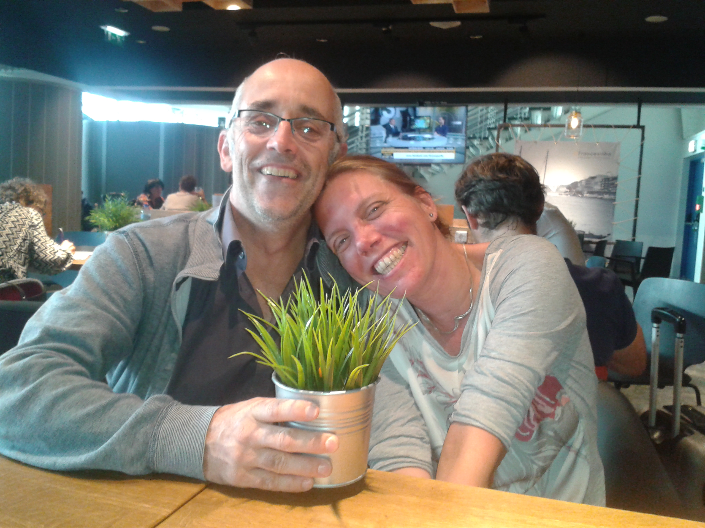
A word of thanks……
EFRO committee
Province Utrecht
NC3Rs
Shell
All participants and collaborators in the projects
My colleagues at the HU and from Vivaltes
All of you for being here
Wish you a great day!

